Slide 1
Poisson-response Tensor-on-Tensor Regression and Applications
Carlos Llosa and Daniel Dunlavy
SAND2026-24182C

Slide 2
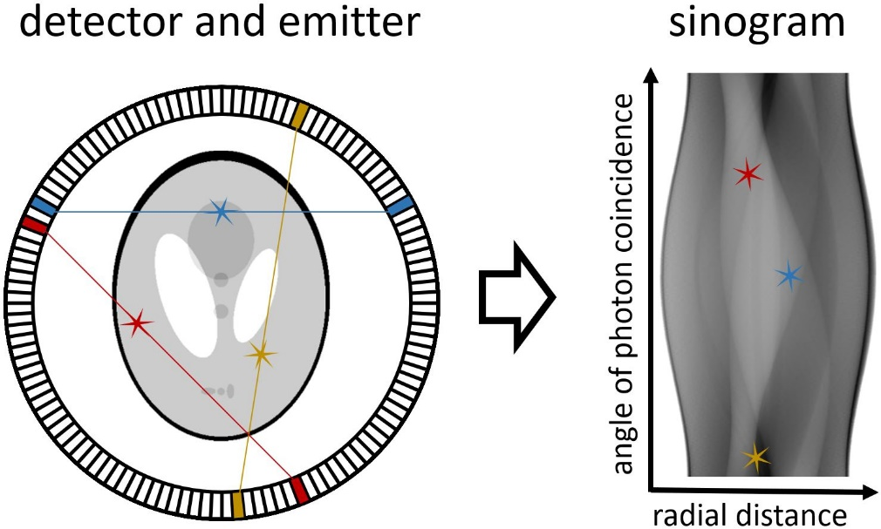
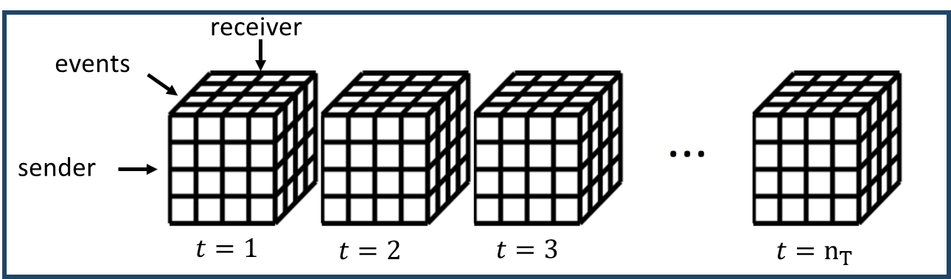
Motivating problems
Temporal prediction of dyadic relationships
ICEWS database [1]
Countries as receivers and senders
Events such as threats or aid
Can we predict future relations?
Change-point detection for multi-way relationships
Enron email database [2]
Employees as senders and receivers
Events such as words or topics of conversation
Are there changes in communication at different times?
Positron emission tomography (PET) reconstruction [3]
Poisson distribution commonly used for photon counts in emission tomography
Statistical model for PET reconstruction is ill-posed without restrictions
Can we reformulate and improve the model using low-rank tensors?
[1] O’Brien, Crisis Early Warning and Decision Support: Contemporary Approaches and Thoughts on Future Research, ISR, 2010.
[2] Enron Email Dataset: https://www.cs.cmu.edu/~enron/
[3] Shepp and Vardi, Maximum Likelihood Reconstruction for Emission Tomography, IEEE TMI, 1982.

Slide 3
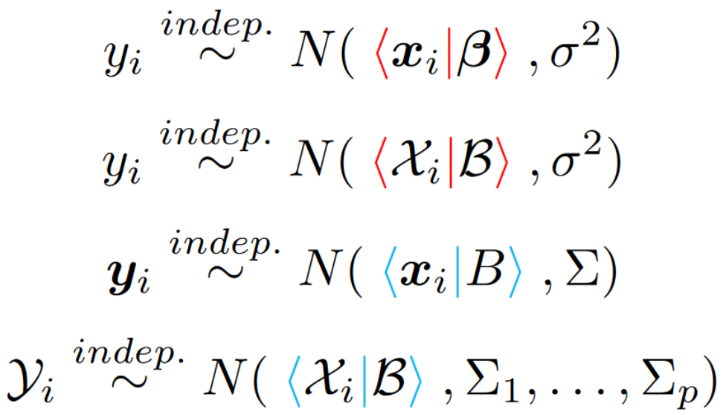
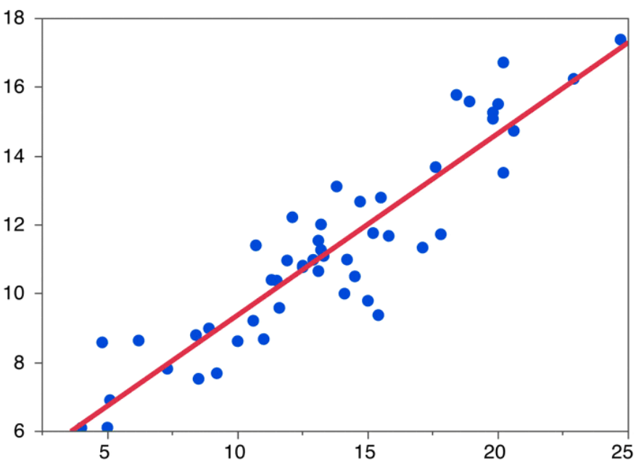
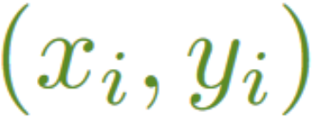
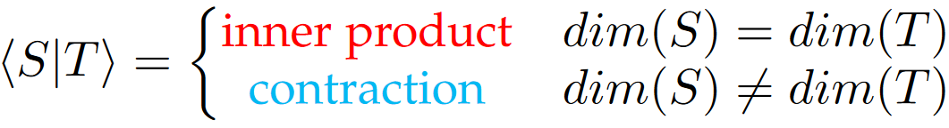





From Linear to Multilinear Regression
Linear regression:
Tensor regression:
Multivariate
linear regression:
Linear regression example
Tensor-on-Tensor
regression [4,5]:
$$m_{1}×…×m_{p}$$
$$h_{1}×…×h_{l}$$
$$h_{1}×…×h_{l}×m_{1}×…×m_{p}$$
Tensor models not tractable without using a very large sample size
[4] Llosa and Maitra, Reduced-Rank Tensor-on-Tensor Regression and Tensor-Variate Analysis of Variance, IEEE TPAMI 2022.
[5] Lock, Tensor-on-Tensor Regression, JCGS, 2018

Slide 4
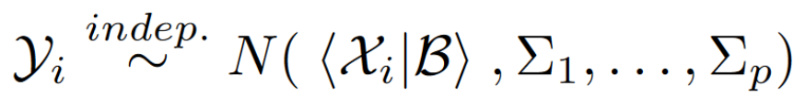

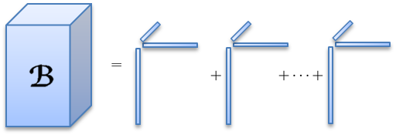
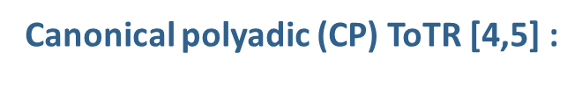
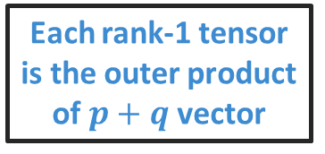
Tensor-on-Tensor Regression (ToTR)
Canonical polyadic (CP) ToTR [4,5] :
Each rank-1 tensor is the outer product of $p+q$ vector
3-dimensional tensor example
Rank-1 tensor
Rank summation
Other low-rank tensor structures studied in [4]
Make the model tractable with low-rank tensors!
[4] Llosa and Maitra, Reduced-Rank Tensor-on-Tensor Regression and Tensor-Variate Analysis of Variance, IEEE TPAMI 2022.
[5] Lock, Tensor-on-Tensor Regression, JCGS, 2018

Slide 5



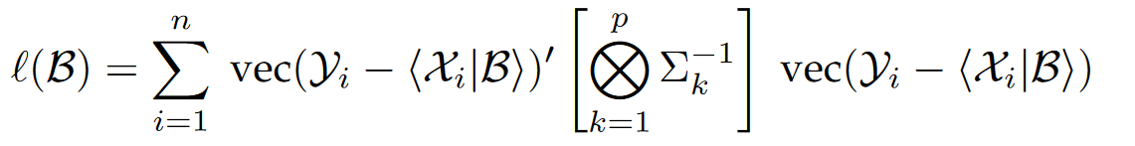
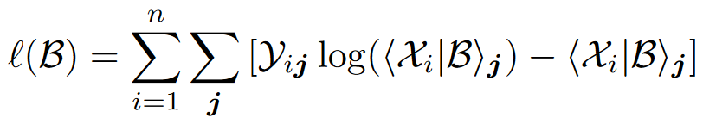
Existing: Gaussian ToTR
New: Poisson ToTR (PToTR)
Loglikelihood:
Loglikelihood:
Least squares loss
CP decomposition constraints
Kullback-Leibler divergence loss
CP decomposition constraints
Strictly positive constraints
Analogous to the existing model, harder to optimize loss function

Slide 6




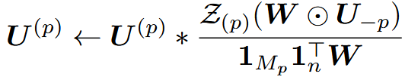
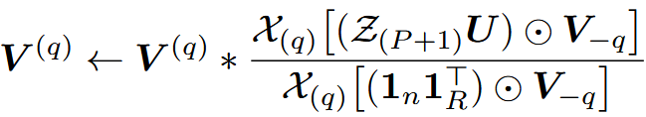
Optimization procedure for PToTR
Model
Loglikelihood
Constraints
> 0
Our new multiplicative update rules extend those in the CP-alternating Poisson regression (CP-APR) algorithm [6]
Multiplicative Updates
(strictly non-decreasing loglikelihood)
Cost
(number of FLOPs)
When or
are sparse, these costs scale with
nnz( ) ,nnz( )
Instead of
dim( ) ,dim( )

Slide 7



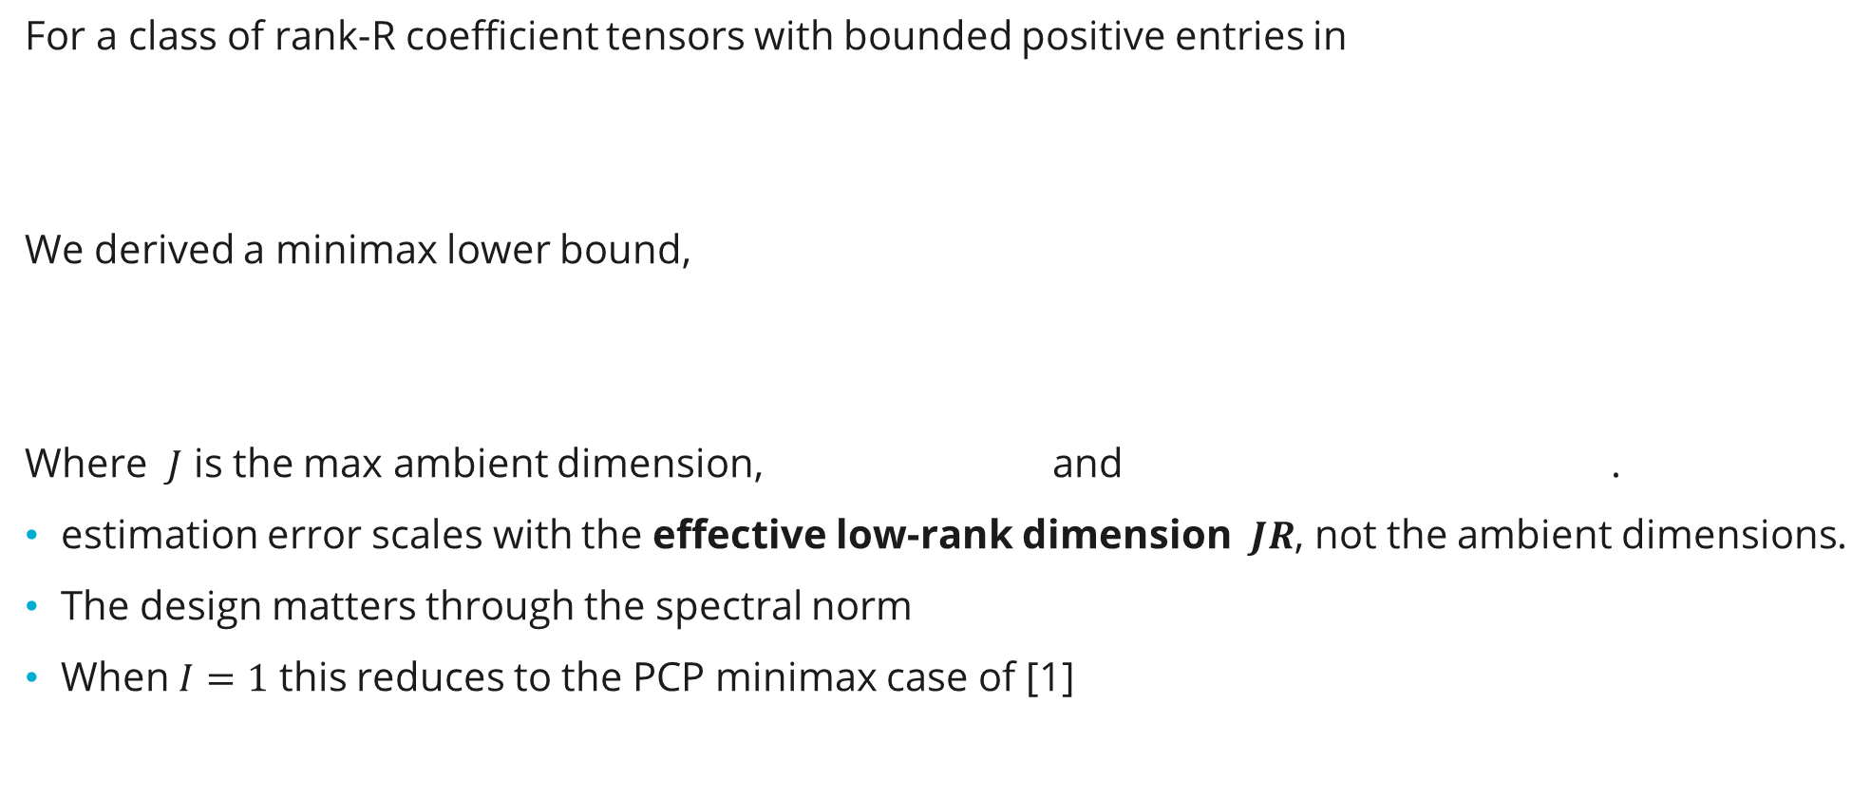
Initial Statistical Theory for PToTR
For a class of rank-R coefficient tensors with bounded positive entries in
We derived a minimax lower bound,
Where $J$ is the max ambient dimension, and .
estimation error scales with the effective low-rank dimension $JR$, not the ambient dimensions.
The design matters through the spectral norm
When $I=1$ this reduces to the PCP minimax case of [1]
[1] Lopez, Prasadan, Llosa-Vite, Lehoucq, Dunlavy, Near-Efficient and Non-Asymptotic Multiway Inference, Under review.

Slide 8

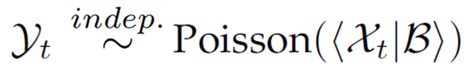
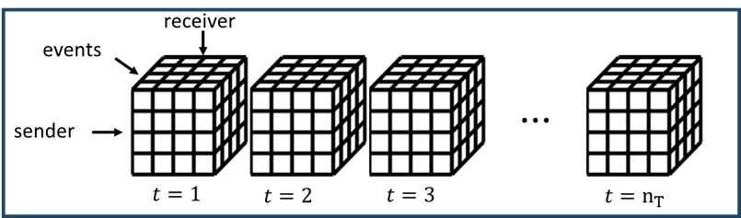
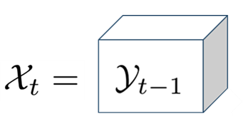
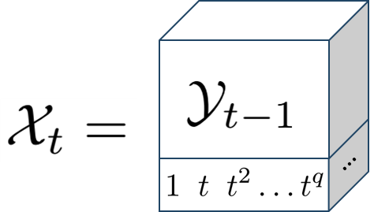
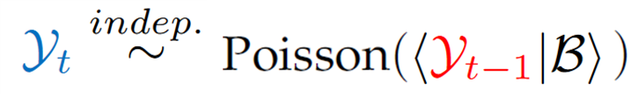
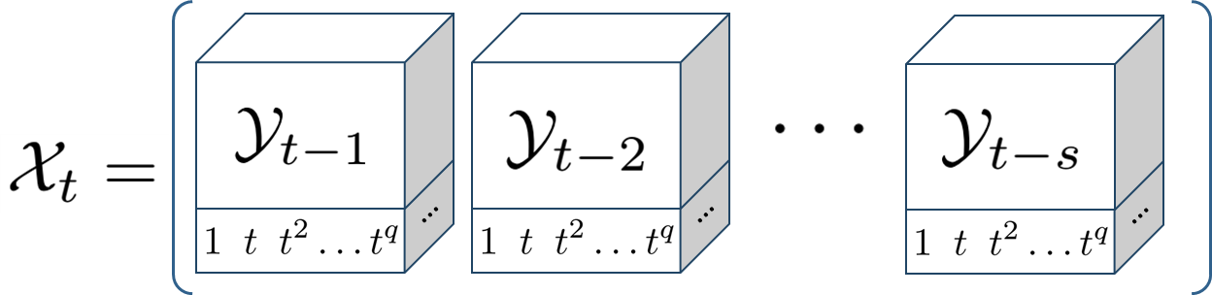
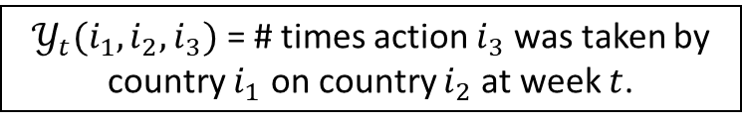
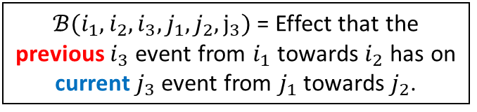
Application I: Autoregressive Model for the ICEWS Database
Other longitudinal effects by choosing in:
AR(1) with no trend (as before):
$𝒴_{t}(i_{1},i_{2},i_{3})$ = # times action $i_{3}$ was taken by country $i_{1}$ on country $i_{2}$ at week $t$.
AR(1) with q-th order polynomial trend:
AR(s) with q-th order polynomial trend:
$ℬ(i_{1},i_{2},i_{3},j_{1},j_{2},j_{3})$ = Effect that the previous $i_{3}$ event from $i_{1}$ towards $i_{2}$ has on current $j_{3}$ event from $j_{1}$ towards $j_{2}$.

Slide 9

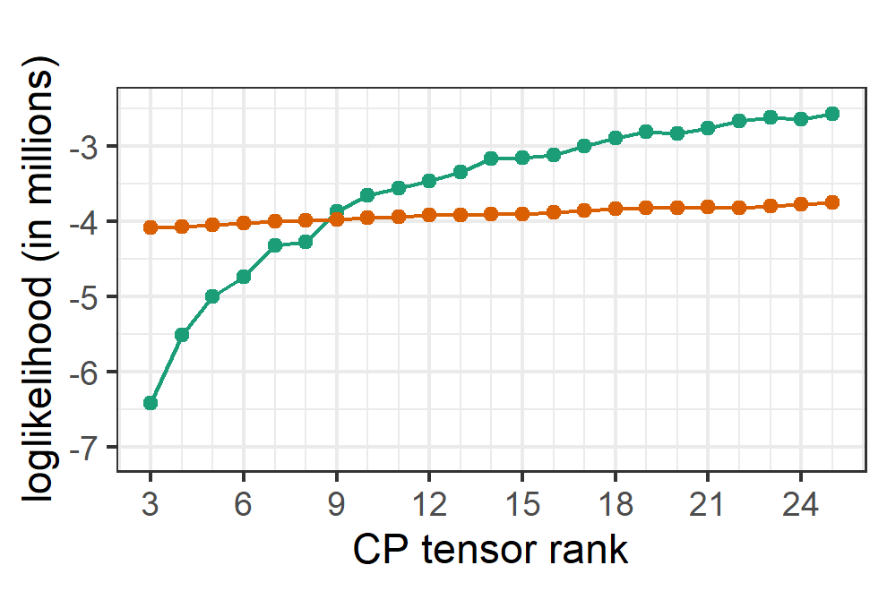
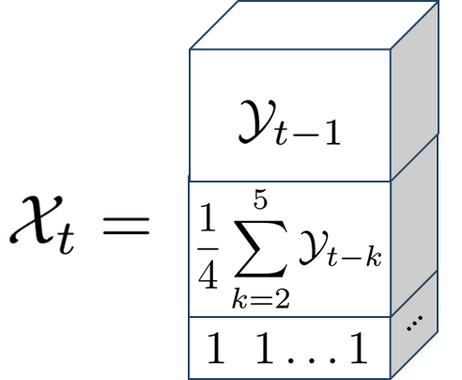
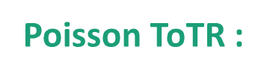

Poisson ToTR :
Application I: Autoregressive Model for the ICEWS Database
Data selected as in [7]:
Weekly data from 2004 to mid-2014
25 countries
4 quad classes (type of events)
previous week
Gaussian ToTR$:$
month before that
mean trend
Our Poisson model fits the count data better!
[7] Hoff, Multilinear tensor regression for longitudinal relational data, Ann. Appl. Stat., 2015

Slide 10

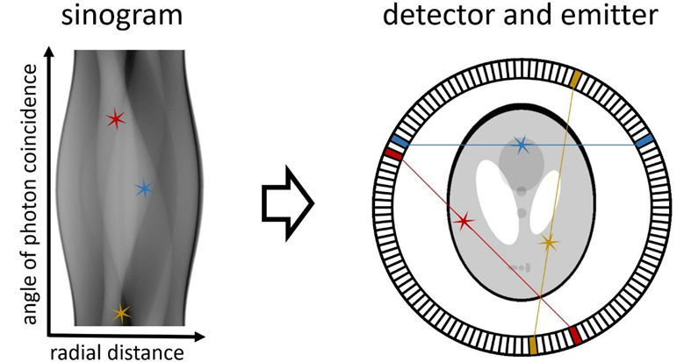


positron emission tomography Image reconstruction
Element-wise regression (ML-EM) [1]:
Ill-posed without constraints [2]
NEW: Poisson-response
Tensor-on-tensor regression (PToTR):
Recovers full image and is well-posed
due to use of low-rank model for
Radon transform of $B$
Observed sinogram
containing counts
Image to reconstruct
[1] Shepp & Vardi (1982); [2] Snyder, Miller, Thomas & Politte (1987)

Slide 11
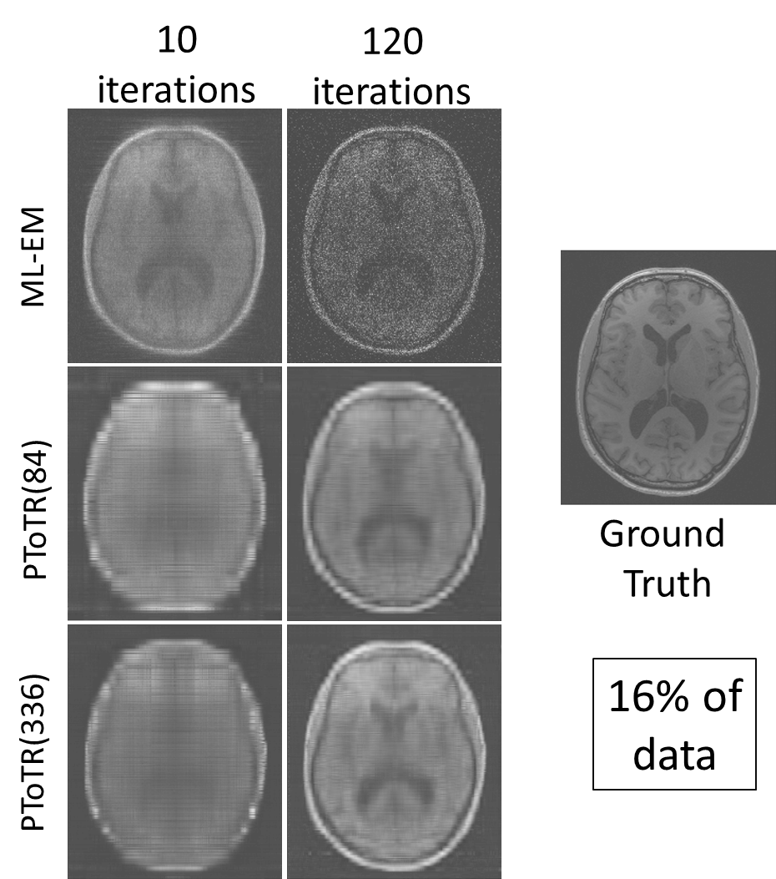
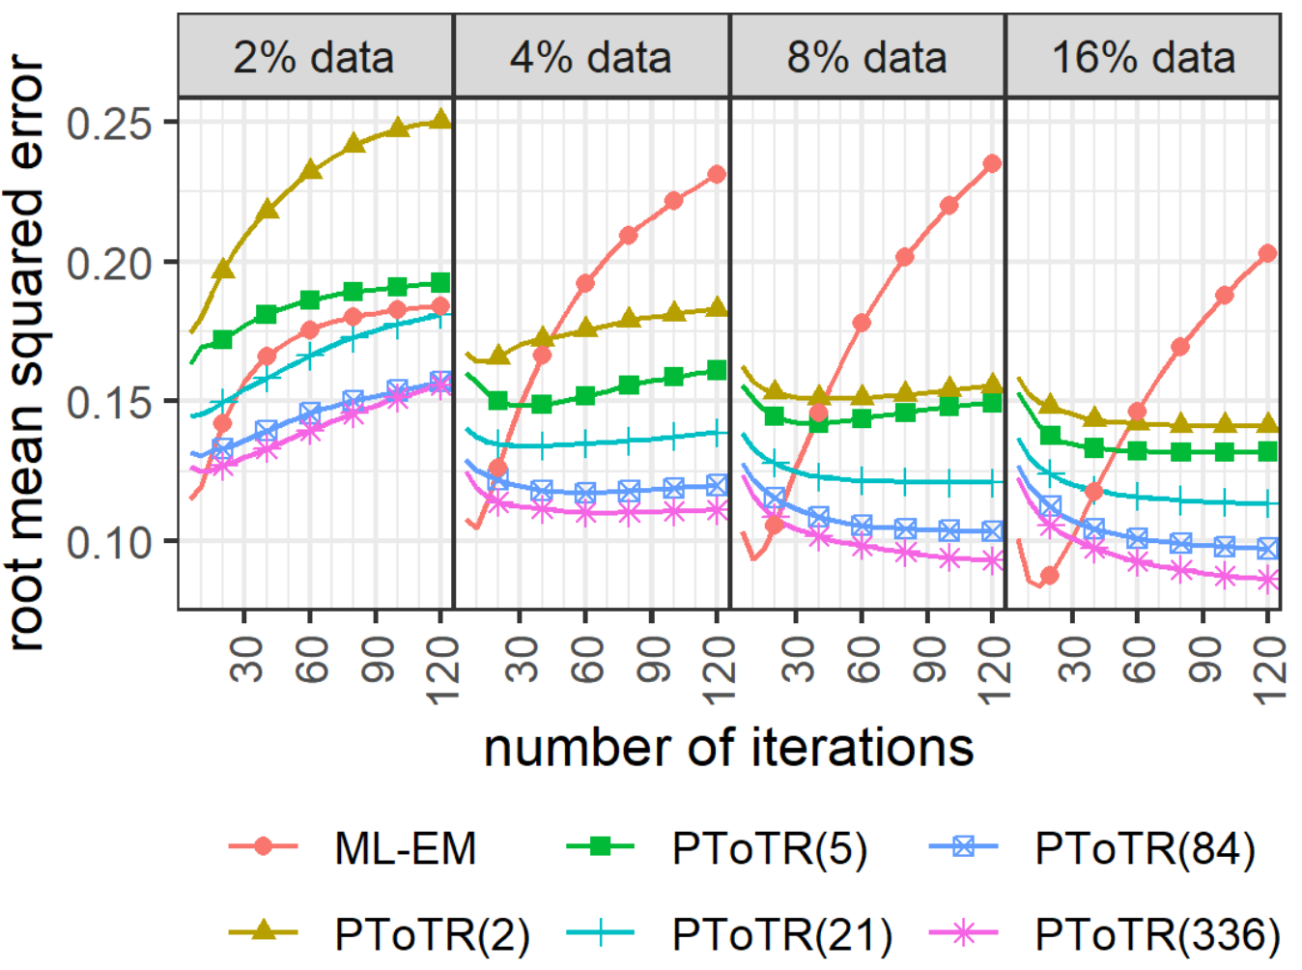
PET Image reconstruction
four MRI measurements on same subject, scanner*
256 x 256 matrix slices → 256 x 1024 sinograms
Parameters: ML-EM (no low-rank): ~ 63 million
PToTR: ~ 63 thousand (rank-84)
*Hawco, et al. (2022)

Slide 12

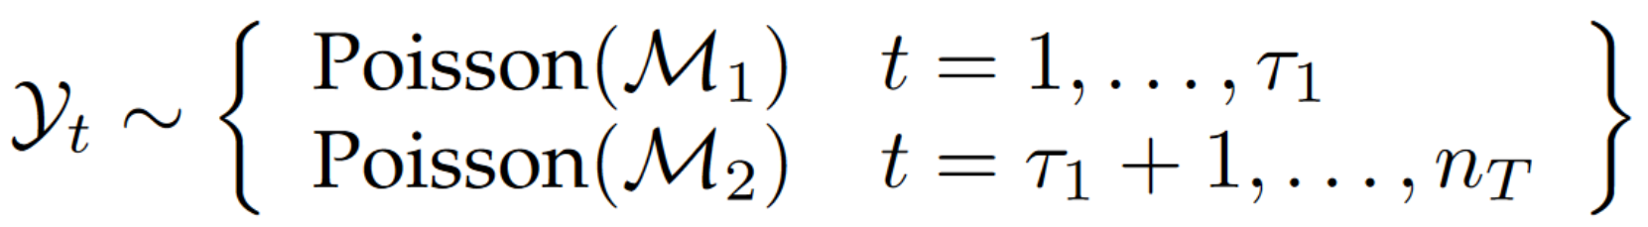

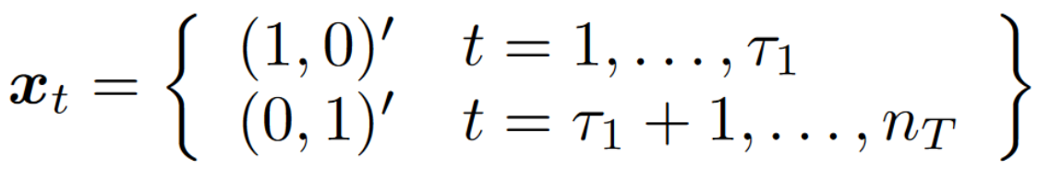


PToTR and Change-Point Detection
Poisson-tensor change-point detection
Equivalent PTANOVA formulation
changes in mean at time
Mean before change-point:
Mean after change-point:
Change-point location:
Mean before change-point:
Mean after change-point:
Change-point location:
Originally solved using PToTR → Now we can perform parameter inference via GToTR

Slide 13
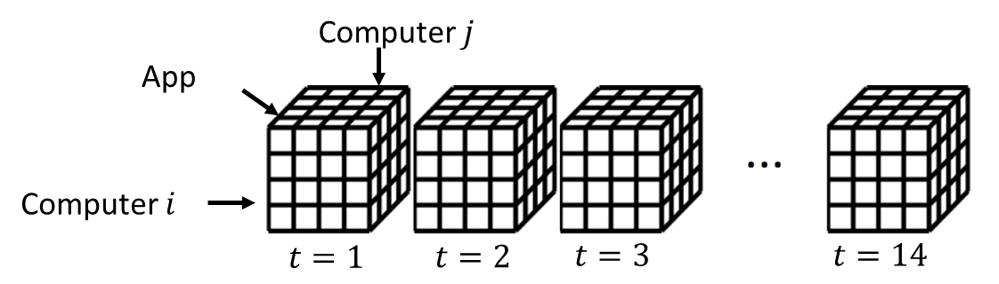
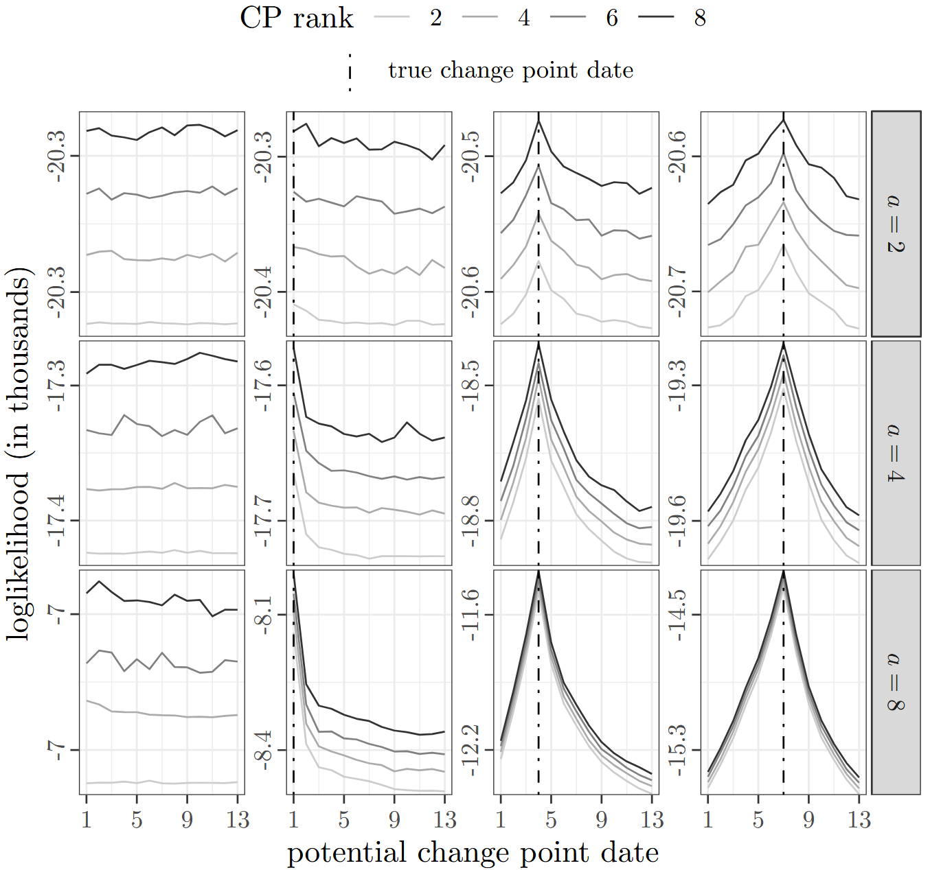
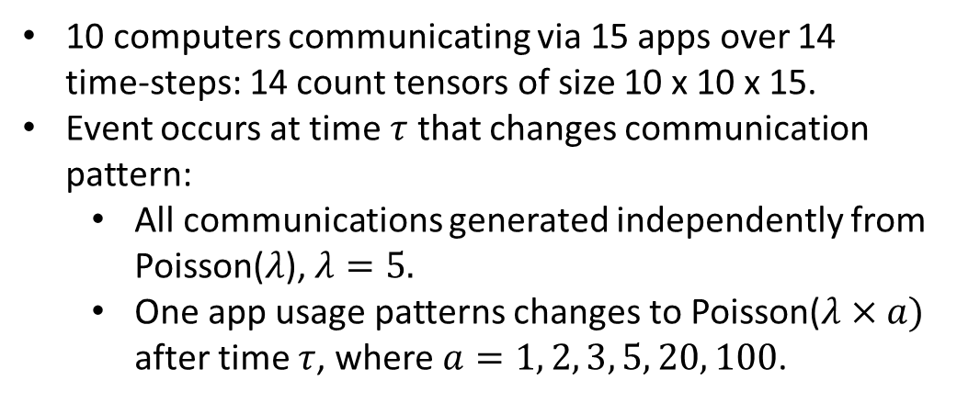
Change-point detection: Simulated Data
10 computers communicating via 15 apps over 14 time-steps: 14 count tensors of size 10 x 10 x 15.
Event occurs at time $τ$ that changes communication pattern:
  All communications generated independently from Poisson($λ$), $λ=5.$
  One app usage patterns changes to Poisson($λ×a)$ after time $τ$, where $a=1, 2, 3, 5, 20, 100$.

Slide 14
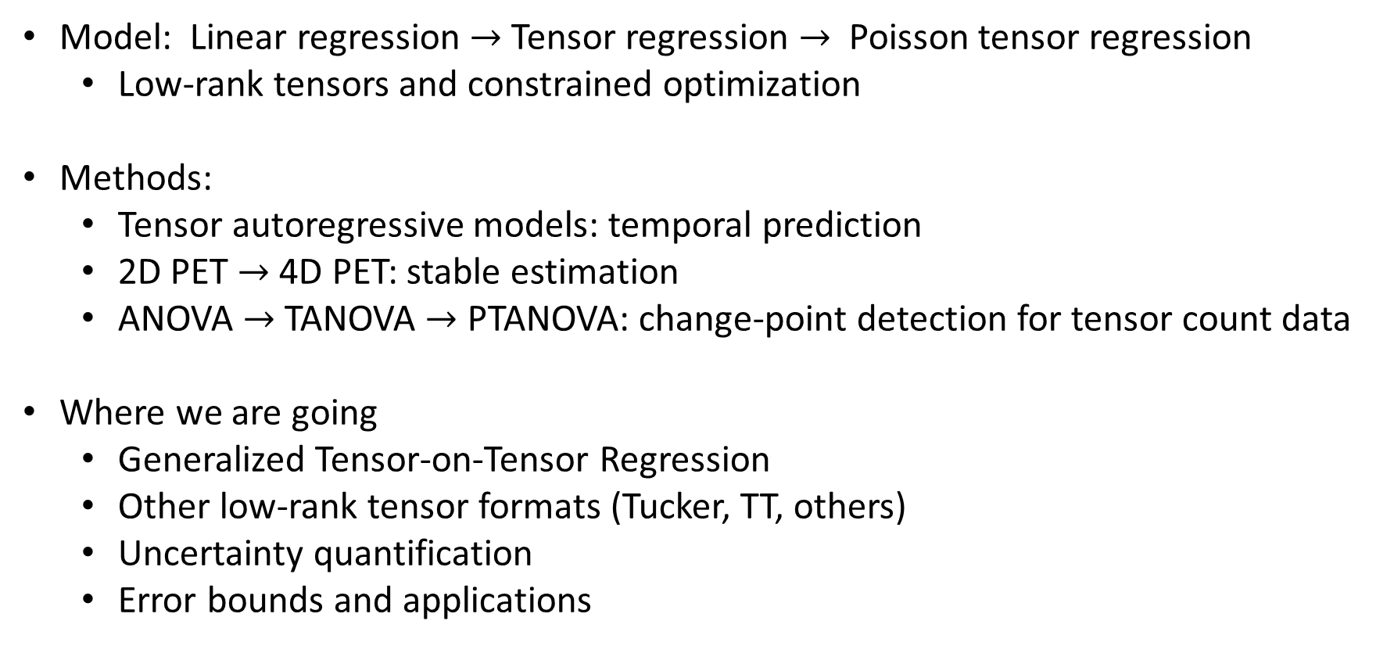
Conclusions and path forward
Model: Linear regression $→$ Tensor regression $→$ Poisson tensor regression
  Low-rank tensors and constrained optimization
Methods:
  Tensor autoregressive models: temporal prediction
  2D PET $→$ 4D PET: stable estimation
  ANOVA $→$ TANOVA $→$ PTANOVA: change-point detection for tensor count data
Where we are going
  Generalized Tensor-on-Tensor Regression
  Other low-rank tensor formats (Tucker, TT, others)
  Uncertainty quantification
  Error bounds and applications

Slide 15
Thank You!
For follow-up questions reach out to:
Carlos Llosa cjllosa@sandia.gov,
Danny Dunlavy dmdunla@sandia.gov
Notes:
(15) Additional info

